Slide 1



ML/DL for Everyone with
Lecture 4: Back-propagation
Sung Kim <hunkim+ml@gmail.com> HKUST
Code: https://github.com/hunkim/PyTorchZeroToAll
Slides: http://bit.ly/PyTorchZeroAll
Videos: http://bit.ly/PyTorchVideo

Slide 2

Call for Comments
Please feel free to add comments directly on these slides.
Other slides: http://bit.ly/PyTorchZeroAll
Picture from http://www.tssablog.org/archives/3280

Slide 3
ML/DL for Everyone with
Lecture 4: Back-propagation & Autograd
Sung Kim <hunkim+ml@gmail.com> HKUST
Code: https://github.com/hunkim/PyTorchZeroToAll
Slides: http://bit.ly/PyTorchZeroAll
Videos: http://bit.ly/PyTorchVideo

Slide 4
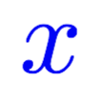
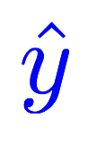

Computing gradient in simple network
Linear
Gradient of loss with respect to w
# compute gradient
def gradient(x, y): # d_loss/d_w
return 2 * x * (x * w - y)
Notes:
loss = (\hat{y}-y)^2 = (x*w-y)^2
\frac{\partial{loss}}{\partial{w}}=?

Slide 5
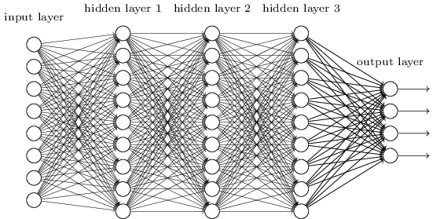
Complicated network?
Gradient of loss with respect to w
Notes:
loss = (\hat{y}-y)^2 = (x*w-y)^2
\frac{\partial{loss}}{\partial{w}}=?

Slide 6
Better way? Computational graph + chain rule
Notes:
loss = (\hat{y}-y)^2 = (x*w-y)^2
\frac{\partial{loss}}{\partial{w}}=?

Slide 7
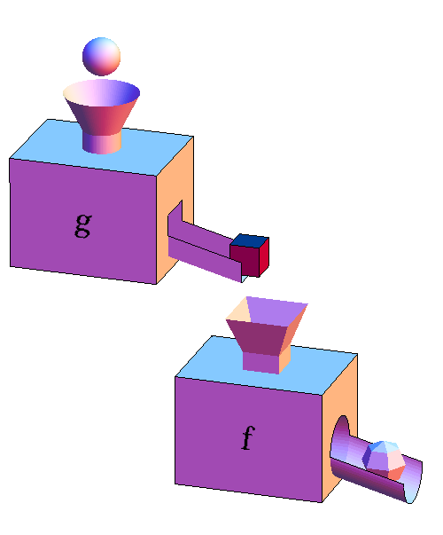
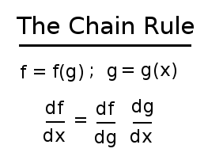
Chain Rule
http://mathinsight.org/image/function_machines_composed

Slide 8
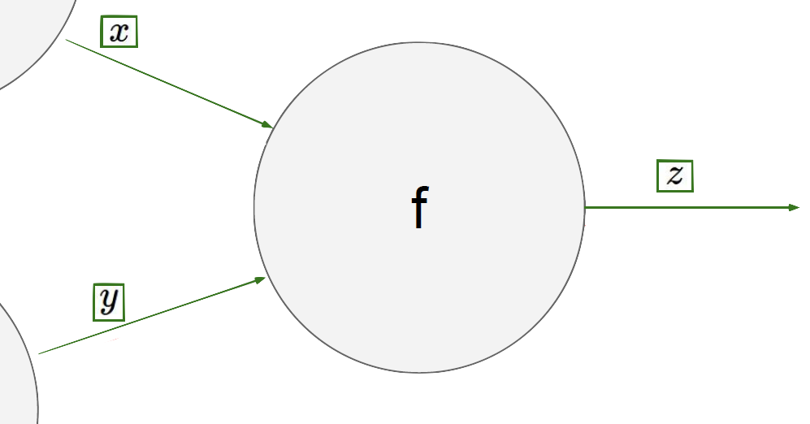
Chain rule
… LOSS

Slide 9
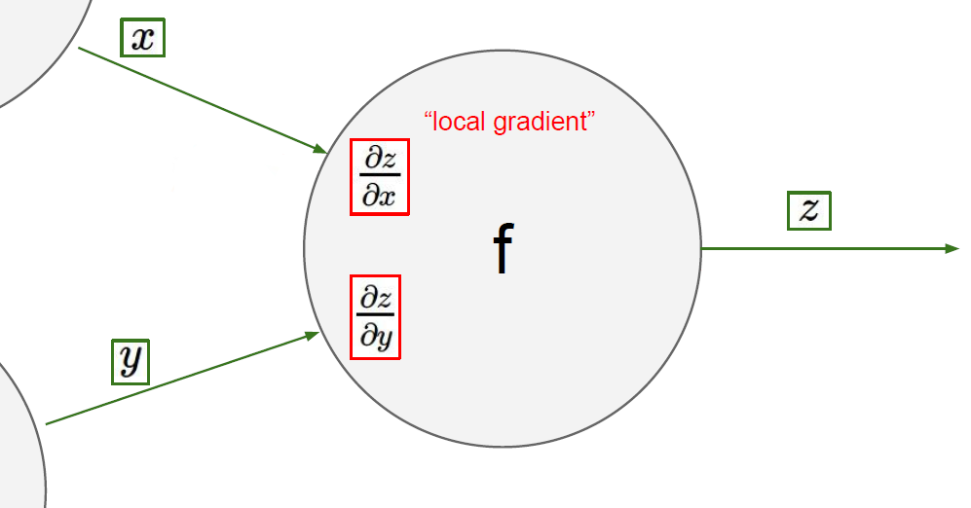
Chain rule

Slide 10
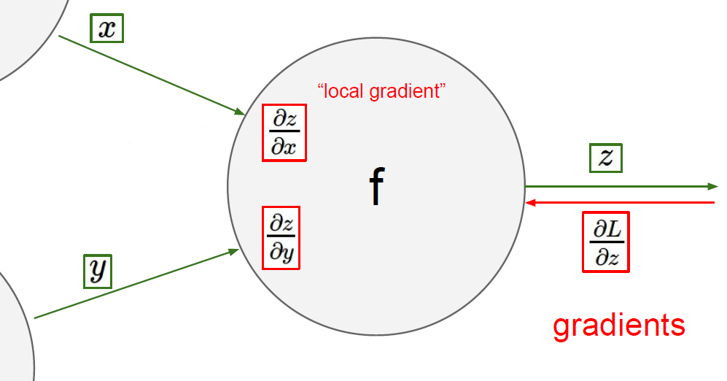

Chain rule

Slide 11
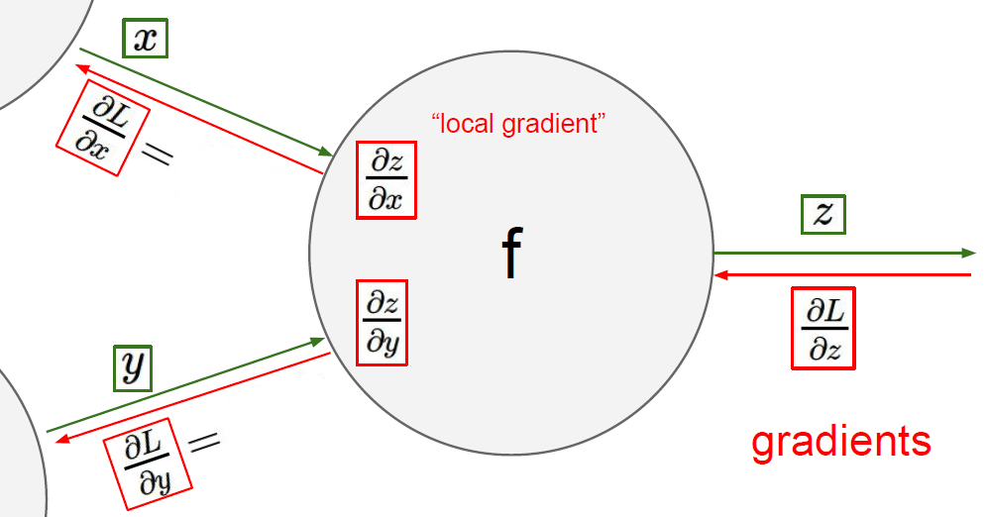
Chain rule

Slide 12

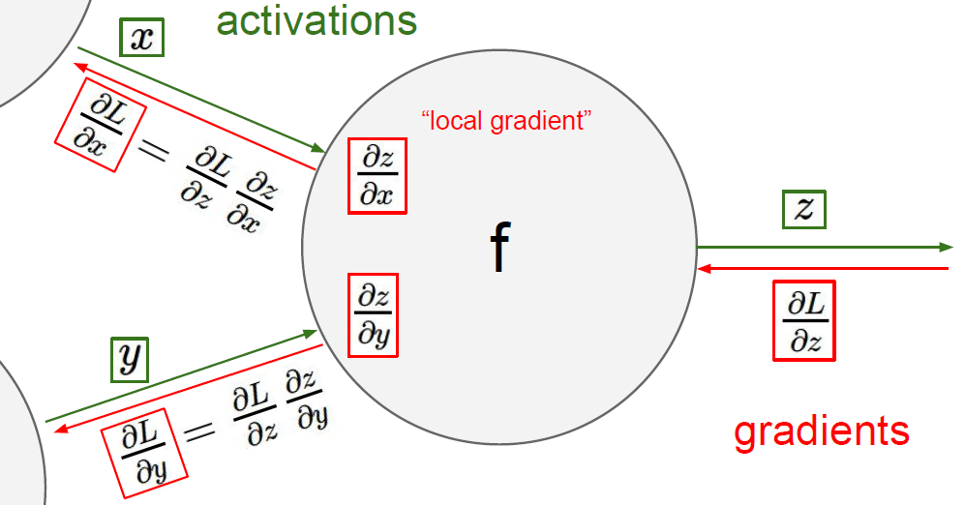
Chain rule

Slide 13
*

Slide 14

Forward pass x= 2, y = 3
*

Slide 15
= 2
*
= 6
= 3

Slide 16

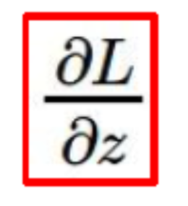
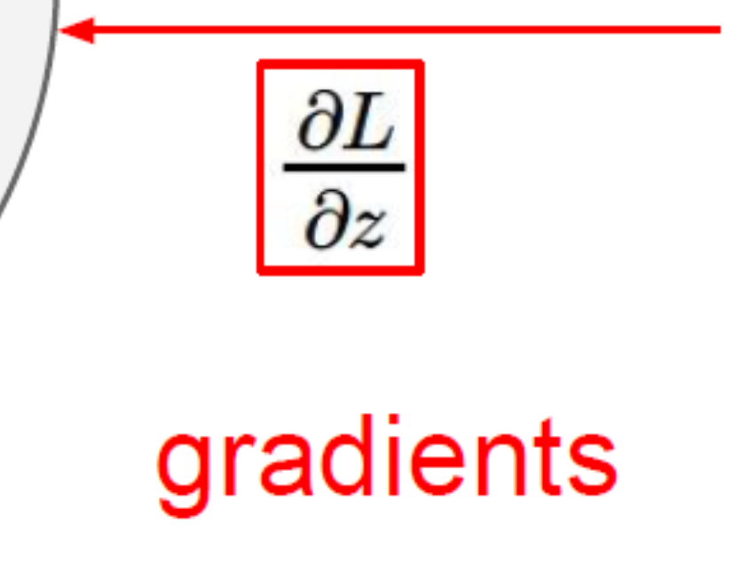
Backward propagation
= 5 is given.
= 2
*
= 6
= 5
= 3

Slide 17
Backward propagation
= 5 is given.
= 2
= y
*
= 6
= x
= 5
= 3
Notes:
由後往前的然後用乘的 所以5*2=10 5*3=15

Slide 18
Backward propagation
= 5 is given.
= 2
= y
*
= 6
= 5*y = 15
= x
= 5
= 3
= 5*x = 10

Slide 19

Computational graph
Notes:
loss = (\hat{y}-y)^2 = (x*w-y)^2
\frac{\partial{loss}}{\partial{w}}=?

Slide 20
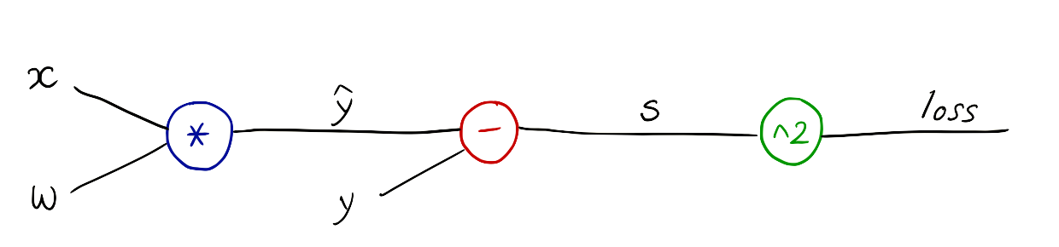
Computational graph
Notes:
loss = (\hat{y}-y)^2 = (x*w-y)^2
\frac{\partial{loss}}{\partial{w}}=?

Slide 21
Computational graph
Notes:
loss = (\hat{y}-y)^2 = (x*w-y)^2
\frac{\partial{loss}}{\partial{w}}=?

Slide 22
Computational graph
Notes:
loss = (\hat{y}-y)^2 = (x*w-y)^2
\frac{\partial{loss}}{\partial{w}}=?
\frac{\partial{z-y}}{\partial{}z}=1

Slide 23
Forward pass x=1, y = 2 where w=1
Notes:
loss = (\hat{y}-y)^2 = (x*w-y)^2
\frac{\partial{loss}}{\partial{w}}=?

Slide 24




Backward propagation
=1
=1
=-1
=1
=1
=2
Notes:
\frac{\partial{\hat{y}-y}}{\partial{\hat{y}}}=1

Slide 25



Backward propagation
=1
=1
=-1
=1
=1
=2
Notes:
X Y W是他給的
Y hat = X*W
y是他原本給的答案 y hat 有點像是我們求出來的值
長的很醜的微積分可以想像成 要把大量資料整理成有價值的內容可以用答案(他給的實際值)和預測出來的值求出誤差s=( yhat-y) loss 就是s^2(平方)
\frac{\partial{\hat{y}-y}}{\partial{\hat{y}}}=1
\frac{\partial{loss}}{\partial{s}}=2s=-2
—-
\frac{\partial{loss}}{\partial{\hat{y}}}
=
\frac{\partial{loss}}{\partial{s}}
\frac{\partial{s}}{\partial{\hat{y}}}
=-2*1=-2
—-

Slide 26


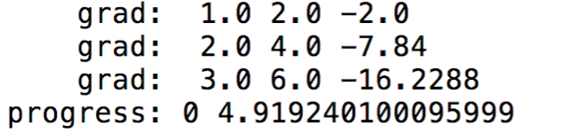
Backward propagation
=1
=1
=-1
=1
=1
=2
Notes:
\frac{\partial{\hat{y}-y}}{\partial{\hat{y}}}=1
\frac{\partial{loss}}{\partial{s}}=2s=-2
—-
\frac{\partial{loss}}{\partial{\hat{y}}}
=
\frac{\partial{loss}}{\partial{s}}
\frac{\partial{s}}{\partial{\hat{y}}}
=-2*1=-2
—-

Slide 27
Exercise 4-1: x = 2, y=4, w=1
=2
=2
=-2
=4
=1
=4
Notes:
\frac{\partial{\hat{y}-y}}{\partial{\hat{y}}}=1

Slide 28

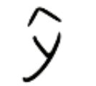

Exercise 4-2: x = 1, y=2, w=1, b=2
+
b
Notes:
loss = (\hat{y}-y)^2 = (x*w-y)^2
\frac{\partial{loss}}{\partial{w}}=?

Slide 29

Data and Variable
import torch
from torch.autograd import Variable
x_data = [1.0, 2.0, 3.0]
y_data = [2.0, 4.0, 6.0]
w = Variable(torch.Tensor([1.0]), requires_grad=True) # Any random value
http://pytorch.org/docs/master/notes/autograd.html?highlight=variable

Slide 30
Data and Variable
http://pytorch.org/docs/master/notes/autograd.html?highlight=variable

Slide 31
Model and Loss
import torch
from torch.autograd import Variable
x_data = [1.0, 2.0, 3.0]
y_data = [2.0, 4.0, 6.0]
w = Variable(torch.Tensor([1.0]), requires_grad=True) # Any random value
# our model forward pass
def forward(x):
return x * w
# Loss function
def loss(x, y):
y_pred = forward(x)
return (y_pred - y) * (y_pred - y)
# Before training
print("predict (before training)", 4, forward(4).data[0])

Slide 32
Training: forward, backward, and update weight
# Training loop
for epoch in range(10):
for x_val, y_val in zip(x_data, y_data):
l = loss(x_val, y_val)
l.backward()
print("\tgrad: ", x_val, y_val, w.grad.data[0])
w.data = w.data - 0.01 * w.grad.data
# Manually zero the gradients after updating weights
w.grad.data.zero_()
print("progress:", epoch, l.data[0])
# After training
print("predict (after training)", 4, forward(4).data[0])

Slide 33
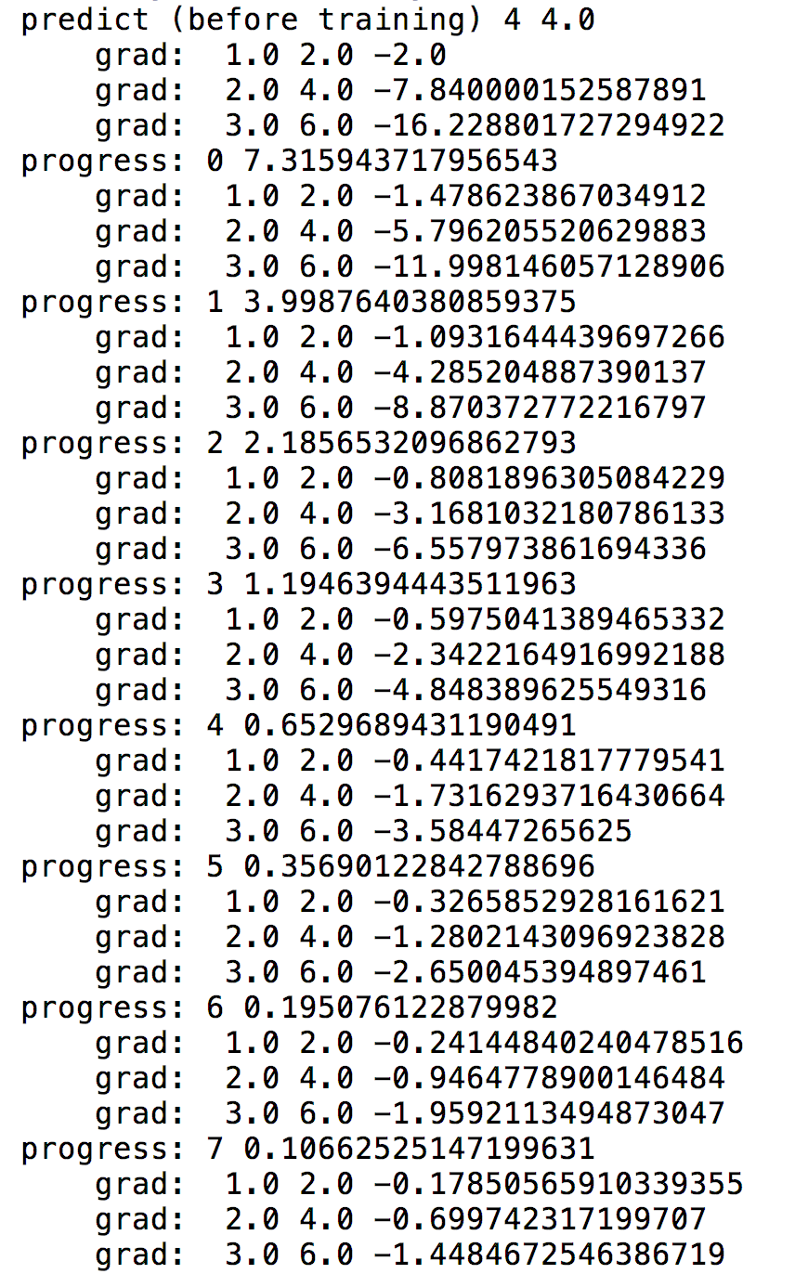
Output
# Training loop
for epoch in range(10):
for x_val, y_val in zip(x_data, y_data):
l = loss(x_val, y_val)
l.backward()
print("\tgrad: ", x_val, y_val, w.grad.data[0])
w.data = w.data - 0.01 * w.grad.data
# Manually zero the gradients after updating weights
w.grad.data.zero_()
print("progress:", epoch, l.data[0])
# After training
print("predict (after training)", 4, forward(4).data[0])

Slide 34
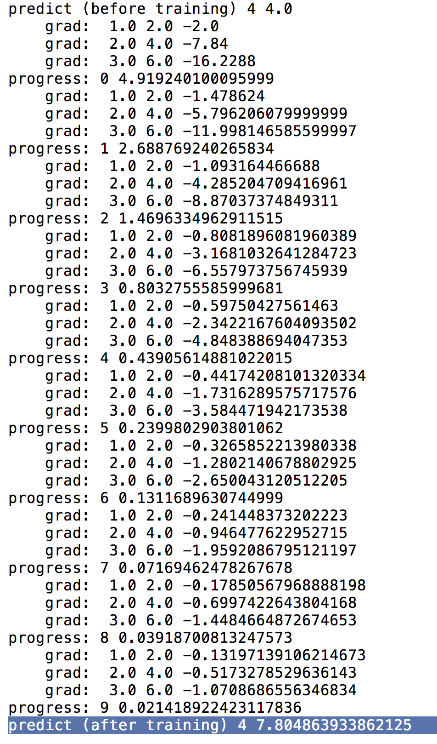
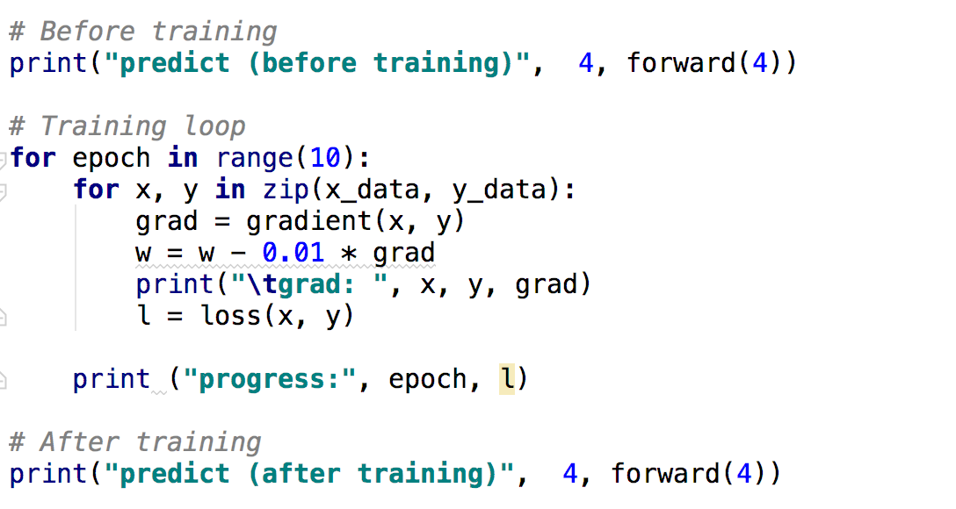
Output
(from numeric gradient computation)

Slide 35
Output
(from numeric gradient computation)
Output
(computational graph)

Slide 36
PyTorch forward/backward
Notes:
loss = (\hat{y}-y)^2 = (x*w-y)^2
\frac{\partial{loss}}{\partial{w}}=?

Slide 37
Forward pass
# Any random value w = Variable(torch.Tensor([1.0]), requires_grad=True)
l = loss(x=1, y=2)
=1
=1
=-1
=1
=1
=2
Notes:
\frac{\partial{\hat{y}-y}}{\partial{\hat{y}}}=1

Slide 38
Back propagation: l.backward()
=2
=2
=-2
=4
=1
=4
w.grad
Notes:
\frac{\partial{\hat{y}-y}}{\partial{\hat{y}}}=1

Slide 39
Weight update (step)
w.data = w.data - 0.01 * w.grad.data
=2
=2
=-2
=4
=1
=4
w.grad
Notes:
\frac{\partial{\hat{y}-y}}{\partial{\hat{y}}}=1

Slide 40
Exercise 4-3: implement computational graph and backprop using NumPy
=2
=2
=-2
=4
=1
=4
Notes:
\frac{\partial{\hat{y}-y}}{\partial{\hat{y}}}=1

Slide 41
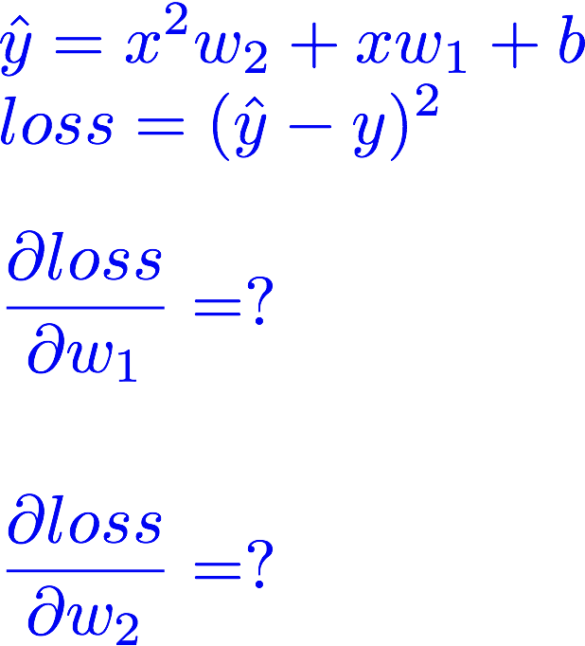
Exercise 4-4: Compute gradients using computational graph (manually)

Slide 42
Exercise 4-5: compute gradients using PyTorch

Slide 43


Lecture 5:
Linear regression
in the PyTorch way

